Slide 1
HOUSING PRiCE PREDICTION

Slide 2
Problem Statement
1-The company is looking at prospective properties to buy houses to enter the market. You are required to build a model using Machine Learning in order to predict the actual value of the prospective properties and decide whether to invest in them or not. For this company wants to know:
• Which variables are important to predict the price of variable?
• How do these variables describe the price of the house?
2-You are required to model the price of houses with the available independent variables. This model will then be used by the management to understand how exactly the prices vary with the variables.
• You need to find important features which affect the price positively or negatively.
• Two datasets are being provided to you (test.csv, train.csv). You will train on train.csv dataset and predict on test.csv file

Slide 3
EXPLORATORY DATA ANALYSIS(EDA)(on training set)

Slide 4
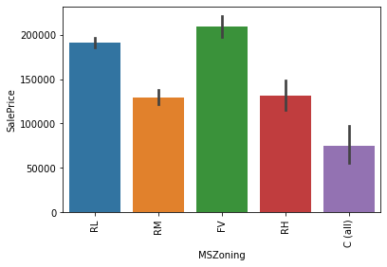
1-Categorical Columns
We have plotted all the categorical columns in he data set against the sale price and observed he relation between them.
1- MSZoning: Identifies the general zoning classification of the sale.
A Agriculture
C Commercial
FV Floating Village Residential
I Industrial
RH Residential High Density
RL Residential Low Density
RP Residential Low Density Park
RM Residential Medium Density

Slide 5
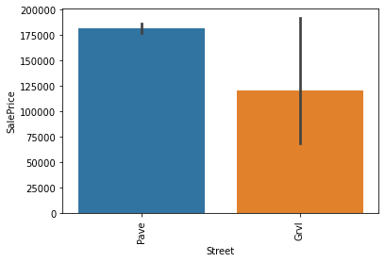
Obs-
1-Floating Village residential has the highest sale price followed by Residential Low density and Residential High density.
2-C(all) have less sale price as compared to others.
2- Street: Type of road access to property
Grvl Gravel
Pave Paved
Obs-
1-Paved road has higher sale prices as compared to gravel

Slide 6
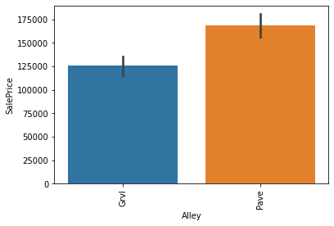
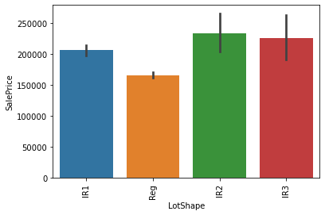
3-Alley: Type of alley access to property
Grvl Gravel
Pave Paved
NA No alley access
Obs-
1- Paved alley has higher sale prices than gravel alley
4- LotShape: General shape of property
Reg Regular
IR1 Slightly irregular
IR2 Moderately Irregular
IR3 Irregular
Obs-
1- Moderately irregular have highest sale price
2-Regular shape have lowest sale prices

Slide 7
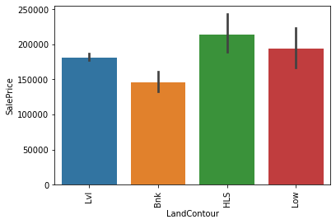
5- LandContour: Flatness of the property
Lvl Near Flat/Level
Bnk Banked - Quick and significant rise from street grade to building
HLS Hillside - Significant slope from side to side
Low Depression
Obs-
1- Hill side property have high sale prices
2-Depression and Near flat property have similar prices
3-Banked have the lowest prices
6-LotConfig: Lot configuration
Inside Inside lot
Corner Corner lot
CulDSac Cul-de-sac
FR2 Frontage on 2 sides of property
FR3 Frontage on 3 sides of property

Slide 8
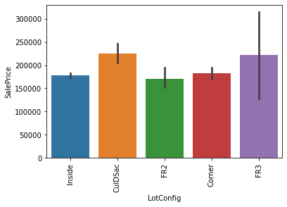
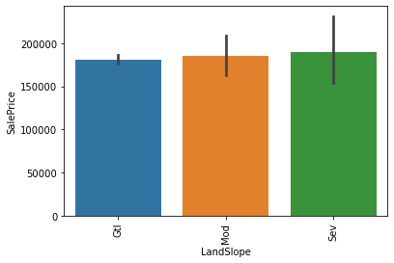
Obs-
1-Fr3 have the highes sale price followed by CuldSac
2-FR2 and Inside have similar house prices
7-LandSlope: Slope of property
Gtl Gentle slope
Mod Moderate Slope
Sev Severe Slope
Obs-
1-Severe slope has higher prices
2-Moderate and Gentle slope have similar prices

Slide 9
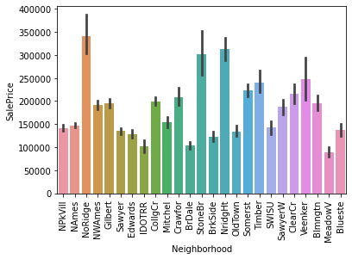
8-Neighborhood: Physical locations within Ames city limits
Blmngtn Bloomington Heights
Blueste Bluestem
BrDale Briardale
BrkSide Brookside
ClearCr Clear Creek
CollgCr College Creek
Crawfor Crawford
Edwards Edwards
Gilbert Gilbert
IDOTRR Iowa DOT and Rail Road
MeadowV Meadow Village
Mitchel Mitchell
Names North Ames
NoRidge Northridge
NPkVill Northpark Villa
NridgHt Northridge Heights
NWAmes Northwest Ames OldTown Old Town
SWISU South & West of Iowa State University
Sawyer Sawyer
SawyerW Sawyer West
Somerst Somerset
StoneBr Stone Brook
Timber Timberland
Veenker Veenker

Slide 10
obs-
1- NoRidge has the highest sale prices followed by StoneBr and NridgHt
2- MeadowV has the lowet sale price followed by BrDale, IDOTRR
9- Condition1: Proximity to various conditions
Artery Adjacent to arterial street
Feedr Adjacent to feeder street
Norm Normal
RRNn Within 200' of North-South Railroad
RRAn Adjacent to North-South Railroad
PosN Near positive off-site feature--park, greenbelt, etc.
PosA Adjacent to postive off-site feature
RRNe Within 200' of East-West Railroad
RRAe Adjacent to East-West Railroad

Slide 11
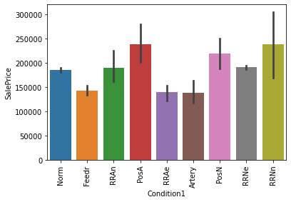
Obs-
1-RRNn (Within 200' of North-South Railroad) has the highest sale prices followed by PosA (Adjacent to postive off-site feature)
2- RRAe (Adjacent to East-West Railroad) and Artery(Adjacent to arterial street) has the lowest sale prices

Slide 12
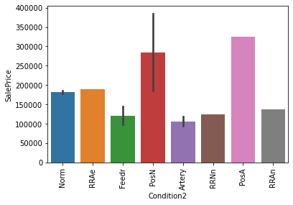
10-Condition2: Proximity to various conditions (if more than one is present)
Artery Adjacent to arterial street
Feedr Adjacent to feeder street
Norm Normal
RRNn Within 200' of North-South Railroad
RRAn Adjacent to North-South Railroad
PosN Near positive off-site feature--park, greenbelt, etc.
PosA Adjacent to postive off-site feature
RRNe Within 200' of East-West Railroad
RRAe Adjacent to East-West Railroad
Obs-
1- PosN (Near positive off-site feature--park, greenbelt, etc.) has the highest sale prices followed by PosA(Adjacent to postive off-site feature
2-Artery(Adjacent to arterial street) followed by Feedr(Adjacent to feeder street) has the lowest sale prices

Slide 13
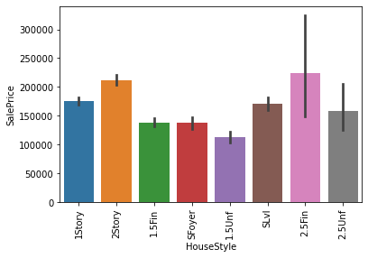
11-HouseStyle: Style of dwelling
1Story One story
1.5Fin One and one-half story: 2nd level finished
1.5Unf One and one-half story: 2nd level unfinished
2Story Two story
2.5Fin Two and one-half story: 2nd level finished
2.5Unf Two and one-half story: 2nd level unfinished
SFoyer Split Foyer
SLvl Split Level
Obs-
1-2.5Fin (Two and one-half story: 2nd level finished) has
the highest sale price followed by 2story,hen by 2.5Unf
2-1.5Unf has he lowest sale prices

Slide 14
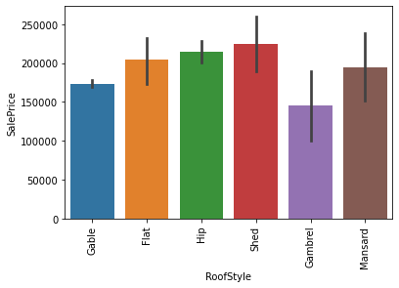
12-RoofStyle: Type of roof
obs-
1- Shed style rrof type has highest sale price
2-Hip, Flat, and Mansard have similar prices
3-Gambrel has the lowest prices
13- MasVnrType: Masonry veneer type
BrkCmn Brick Common
BrkFace Brick Face
CBlock Cinder Block
None None
Stone Stone

Slide 15
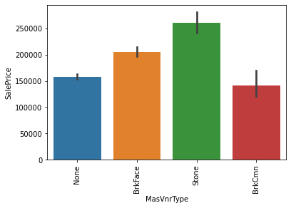
Obs-
1- Stone masonry have the highest sale price
2- followed by Brick face
3- There are also houses with none of the
Masonry type
15-Foundation: Type of foundation
BrkTil Brick & Tile
CBlock Cinder Block
PConc Poured Concrete
Slab Slab
Stone Stone
Wood Wood

Slide 16
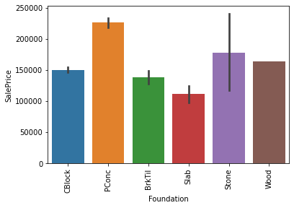
Obs-
1-Poured Cocrete have the highest sale price
Followed by stine foundation.
2-followed by Wood,CBlock ,BrkTil foundation
3- Slab foundation has the least sale prices
16HeatingQC: Heating quality and condition
Ex Excellent
Gd Good
TA Average/Typical
Fa Fair
Po Poor-

Slide 17
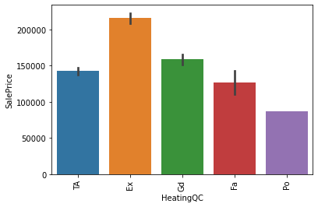
Obs-
1-The better the heating quality condition the
higher the prices.
17-Electrical: Electrical system
SBrkr Standard Circuit Breakers & Romex
FuseA Fuse Box over 60 AMP and all Romex wiring (Average)
FuseF 60 AMP Fuse Box and mostly Romex wiring (Fair)
FuseP 60 AMP Fuse Box and mostly knob & tube wiring (poor)
Mix Mixed

Slide 18
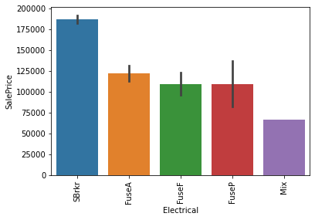
Obs-
1-house having SBrkr have high sale prices.
2-followed by houses having FuseA
3- Houses with FuseF and FuseP have similar
prices.
18-KitchenQual: Kitchen quality
Ex Excellent
Gd Good
TA Typical/Average
Fa Fair
Po Poor

Slide 19
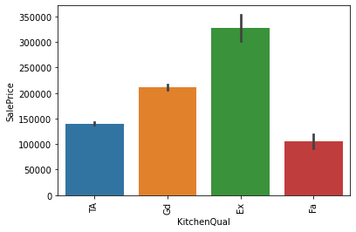
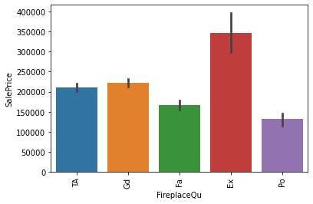
Obs-
1-The better the kitchen quality the higher the prices.
19-FireplaceQu: Fireplace quality
Obs-
1-The better the FirePlace quality the higher the prices.
2- Some houses even have poor quality, but still sold
for more than 1lakh.

Slide 20
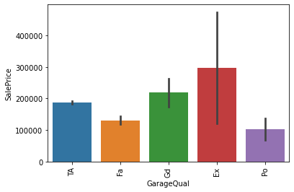
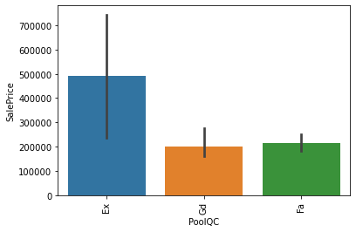
20-GarageQual: Garage quality
Obs-
1-The better the Garage quality the higher the prices.
2- Some houses even have poor Garage quality, but still sold
for more than 50000.
21-PoolQC:Pool Quality
Obs-
1-The better the Garage quality the higher the prices.
2- Houses with Good and Fair quality pool quality have
similar prices

Slide 21
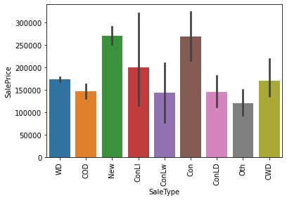
22-SaleType: Type of sale
WD Warranty Deed – Conventional
CWD Warranty Deed - Cash
VWD Warranty Deed - VA Loan
New Home just constructed and sold
COD Court Officer Deed/Estate
Con Contract 15% Down payment regular terms
ConLw Contract Low Down payment and low interest
ConLI Contract Low Interest
ConLD Contract Low Down
Oth Other
Obs-
1-Con(Contract 15% Down payment regular terms) have the highest sale prices, followed by New(Home just constructed and sold), ConLi(Contract Low Interest), CWD Warranty Deed – Cash
2- Other type of house have less sale price.

Slide 22
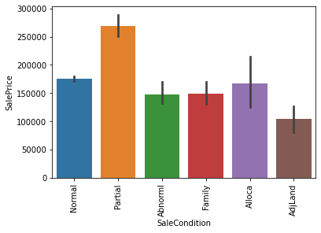
23-SaleCondition: Condition of sale
Normal Normal Sale
Abnorm Abnormal Sale - trade, foreclosure, short sale
AdjLand Adjoining Land Purchase
Alloca- Allocation - two linked properties with separate deeds, typically condo with a garage unit
Family Sale between family members
Partial Home was not completed when last assessed
Obs-
1- Houses with Partial sale condition have the highest sale
prices.
2-followed by Normal and Alloca Sale condition
3-Abnormal and Family type have similar sale prices.
4-Adj Land have the least sailing Prices

Slide 23
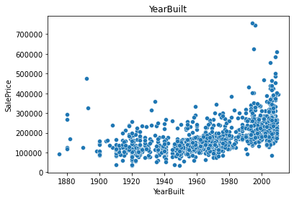
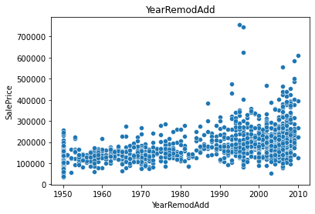
2-Year Features
1-Year Built- In which year he model was built
Obs-
1-The newer the model the better the sale prices
2-YearRemodAdd: Remodel date (same as construction date if no remodeling
Obs-
1-The latest the remodel date, the higher the prices

Slide 24
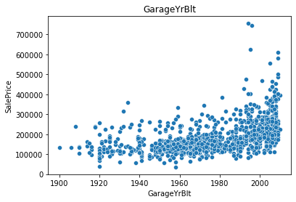
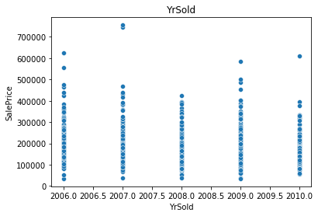
3- GargeYrBuilt: Garage Building year
Obs-
1-The newer the Garage Building date, the higher
the prices.
4-Year Sold
Obs-
1-In 2007 highest price house were sold upto 7lakh
2-In 2008, the prices of the house went below 5lakh

Slide 25
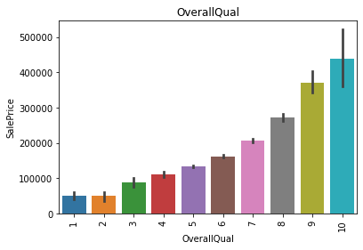
3- Discrete Features
1-OverallQual: Rates the overall material and finish of the house
10 Very Excellent
9 Excellent
8 Very Good
7 Good
6 Above Average
5 Average
4 Below Average
3 Fair
2 Poor
1 Very Poor
Obs-
1-The better he quality of the house the higher the prices.

Slide 26
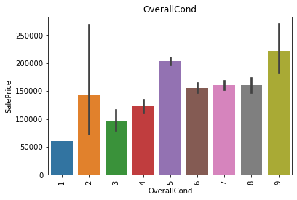
2-OverallCond: Rates the overall condition of the house
10 Very Excellent
9 Excellent
8 Very Good
7 Good
6 Above Average
5 Average
4 Below Average
3 Fair
2 Poor
1 Very Poor
Obs-
1-Excellent conditioned houses have the highest sale prices
2-Average conditioned houses have the 2nd highest sale prices
3-6,7,8 conditioned houses have similar prices
4-Very poor conditioned houses have the least prices.

Slide 27
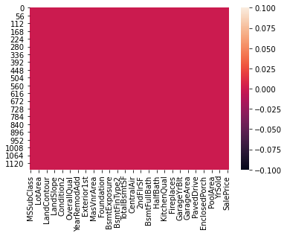
Working on Training and Testing set
1- finding the null values on the training set.
2- filling the null values, with mean in numerical columns and,with mode in categorical columns.
3-Eliminaing the columns having more than 70% null values
4-
Heatmap showing, no null values in the training dataset.

Slide 28
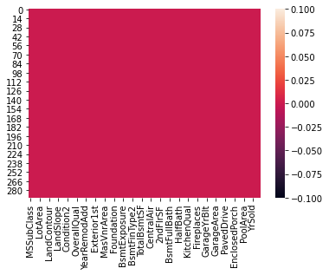
5- Performing the same feature engineering steps and filling the null values in the testing dataset.
6-
Heatmap showing , no null values present in the testing dataset.
7- Joining both the training and testing datasets.
8- Encoding using, Ordinal Encoder, for encoding the categorical columns in the d(train+test) set.
9-Again splitting the two sets, using iloc method, into d_trainset and d_testset
10- Using the Variance Threshold method to find out the feature having only same response,(i.e- Utilities) and removing it from both d_trainset and d_testset

Slide 29
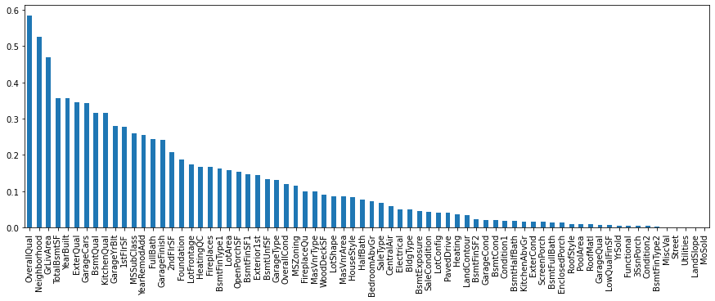
11- Dropping columns based on correlation using Mutual Info .
12- Now separating x(feature) and y(target) variable from the d_trainset.
13- finding out the most contributing feature towards the targe variable and removing the least contributing feature from d_testset and d_trainset.(i.e-

Slide 30
Obs-
1-The histogram shows feature columns in decreasing order of their importance towards the target variable
2-OverallQual followed by Neighbourhood and GrLivArea are the most contributing features for housing price
3-Least Important Feature- MoSold,Condition2,Street,GarageQual,BsmtFinType2
14- using Standard Scaler for scaling the x feature.

Slide 31
Model Selection
1-After selecting the x and y variable,we then perform the train_test_split and and check the training and testing in various models.
2-Models used – LinearRegression, DecisiontreeRegressor, KNeighborsRegressor, SVR, RandomForestRegressor, AdaBoostRegressor, GradientBoostRegressor,
3-Train_test_split was used to find out the accuracy of each model.
4-After this cross_val_score of each model was calculated.
5-By compairing the accuracy score with cross_val_score, GradientBoostRegressor was found to be most efficient model.
6-After this Hypertest tuning was done through GridSearchCv to find out the best parameter for GradientBoostRegressor

Slide 32

Prediction and Conclusion
1- GradientBoostingRegressor was used for predicting the prices on the d_trainset showed ,84% accuracy.
2- GradientBoostingRegressor was used for predicting the Sale Price on the testing set.
3-Conclusion-

Slide 33
Obs-
1.OverAllQual,Neighbourhood,GrLivArea,TotalBsmtSf,YearBuilt,,Exernalqual,BSmtQual,KitchenQual, GarageYrBuilt, 1sFlrSf, MSClass,YarModAdd,FullBath,GarageFinish,2ndFlrSF,Foundation,LotFronage, HeatingQl,FirePlace,LotArea,OpenPorschSF, are the feaures arranged in the decreasing order of their contribution respectively to the Sale Prices of the Housing
2.Least Important Feature- MoSold,Condition2,Street,GarageQual,BsmtFinType2

Slide 34
Limitation
1- GradientBoosting regressor is working with 84% accuracy.
2-The prediceted values have margin of error of 16%.

Slide 35
Thank you
submitted by- Akashdeep Singh Manral
Batch- 1834

